Slide 1
Using Sentence-level Context as a Clue to the Meaning of a Word or Phrase
Mrs. Eide’s
2nd Grade Class
Renee Simpson Literacy Facilitator
Mathias Elementary
Rogers, AR
March 6, 2012

Slide 2

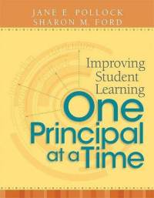
GANAG is a lesson structure that allows teachers to plan for student use of research based instructional strategies.
G= goal
A= access prior knowledge
N= new information
A= application
G= generalize the goal

Slide 3
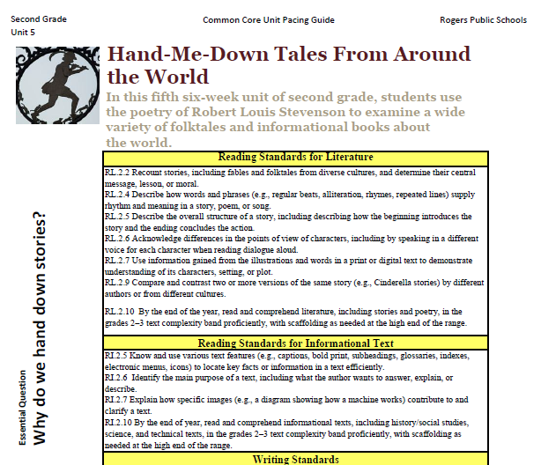

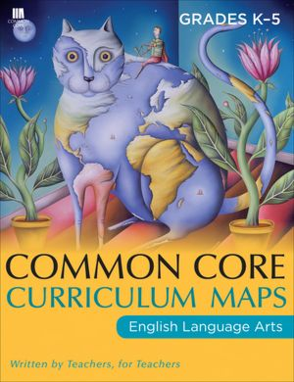
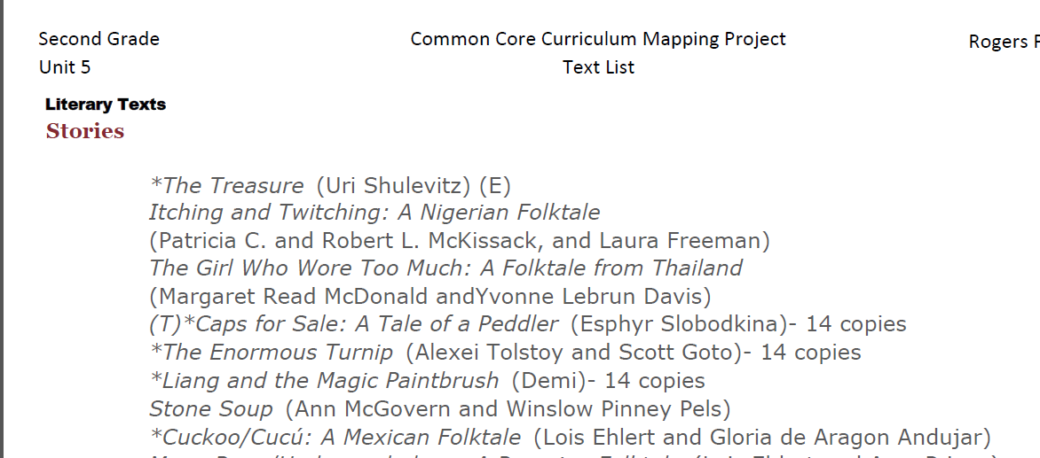
Mrs. Eide began her planning with the pacing guide. She selected a standard.
L.2.4 Determine or clarify the meaning of unknown and multiple-meaning words and phrases based on grade 2 reading and content, choosing flexibly from an array of strategies.
a. Use sentence-level context as a clue to the meaning of a word or phrase.
Next she selected a text from the suggested works listed in Unit 5.

Slide 4
Purpose of the GANAG Structure
To give students the opportunity to actively use the nine high-yield strategies:
(2) Identifying Similarities and Differences
(7) Cooperative Learning
(8) Setting Objectives and Providing Feedback
(3) Summarizing and Note Taking
(4) Reinforcing Effort and Providing Recognition
(9) Generating and Testing Hypotheses
(5) Homework and Practice
(10) Cues, Questions and Advance Organizers
(6) Nonlinguistic Representations

Slide 5
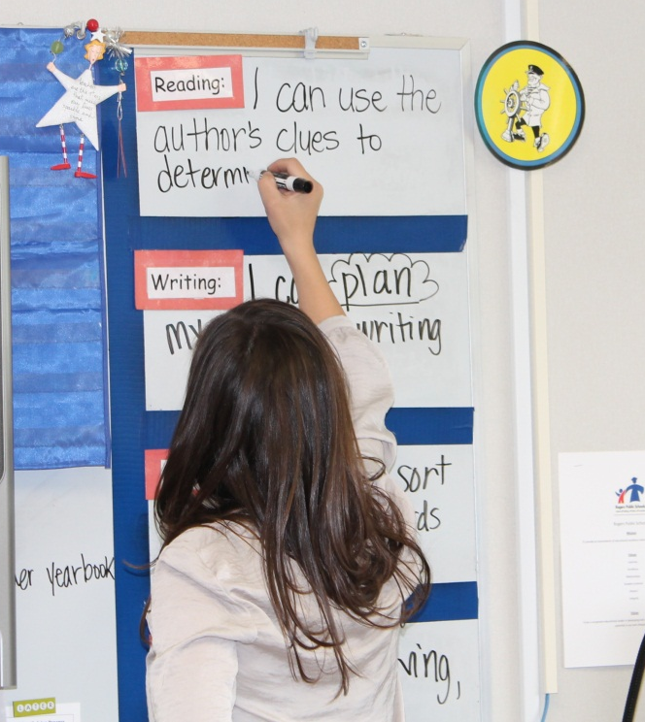
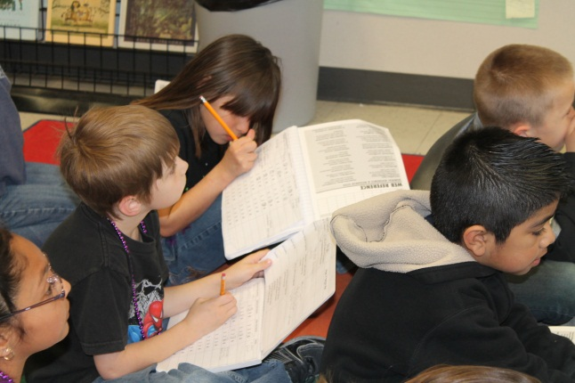
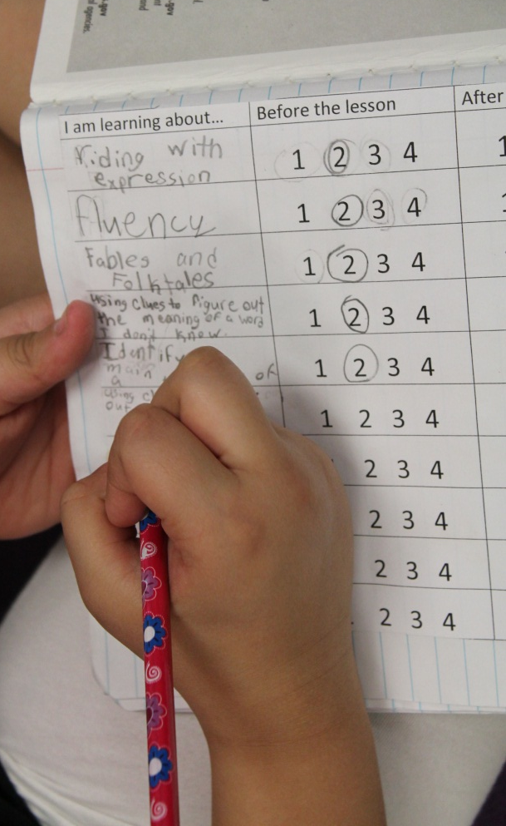
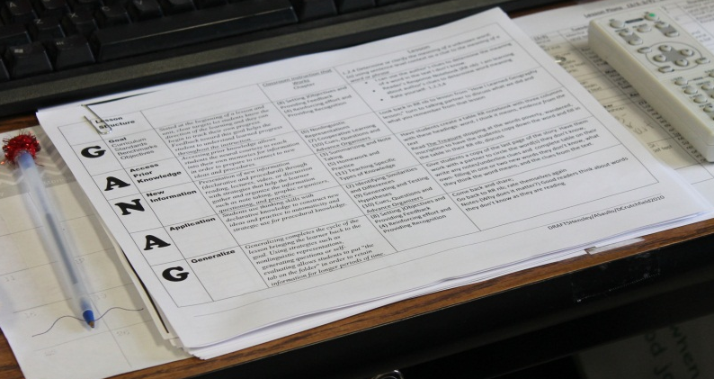
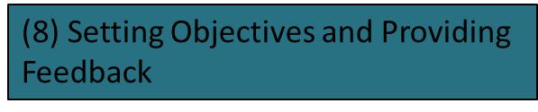
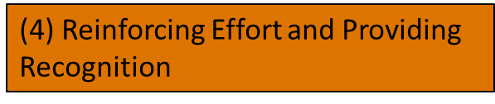
I can use the author’s clues to determine the meaning of a word.
G=Set the Goal
Students write the goal for the lesson and score themselves.

Slide 6
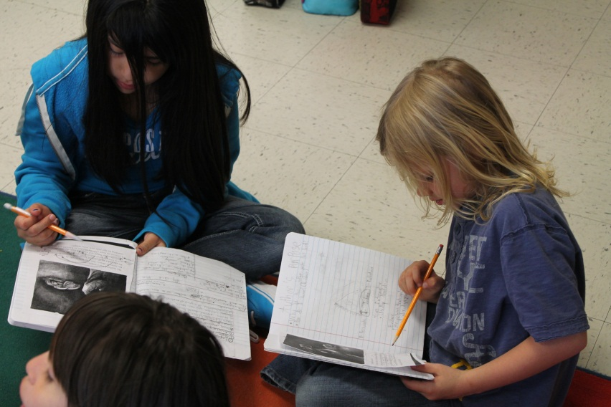
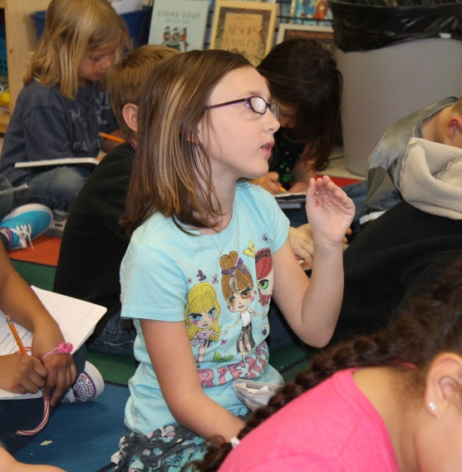

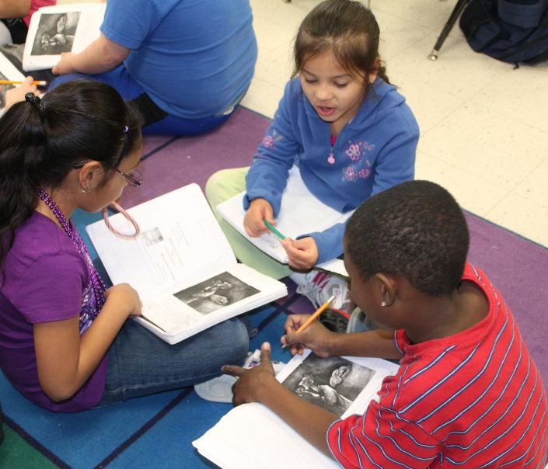
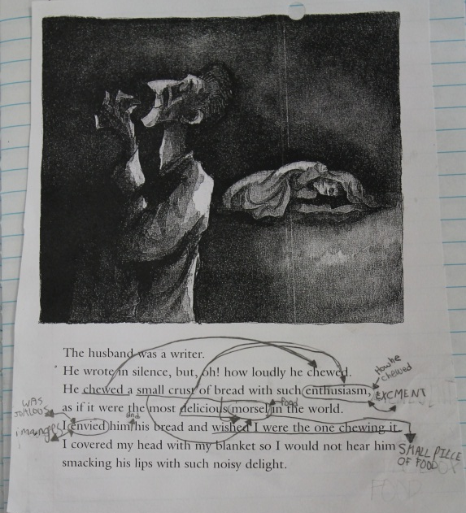
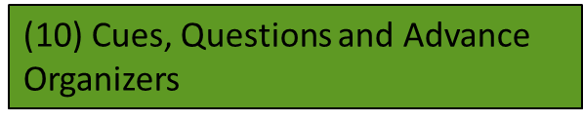
A=Access Prior Knowledge
Open your notebook.
Turn to your notes from How I Learned Geography.
Turn to your learning partner and discuss what we learned.
Report back…What do you remember?
(6) Nonlinguistic Representations

Slide 7
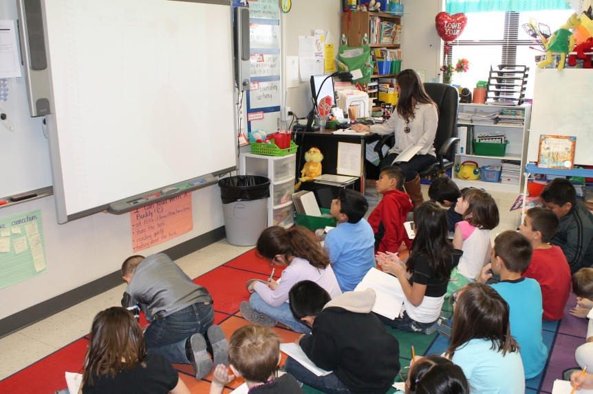
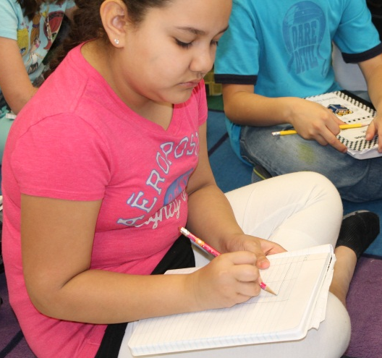
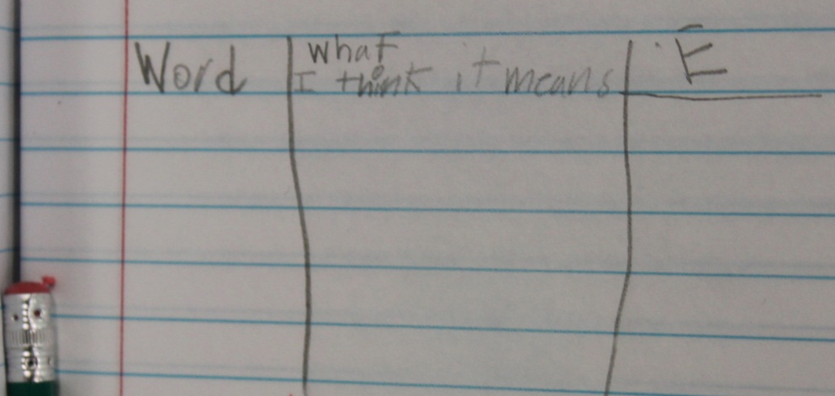


N= New Information
Read The Treasure by Uri Shulevitz
Before beginning to read, Mrs. Eide asked the students to draw a 3-column table in their notebooks. She modeled the table using her own notebook and a document camera.
Some students had their table finished before Mrs. Eide.
The students have become very familiar with finding “Evidence” in the text.

Slide 8
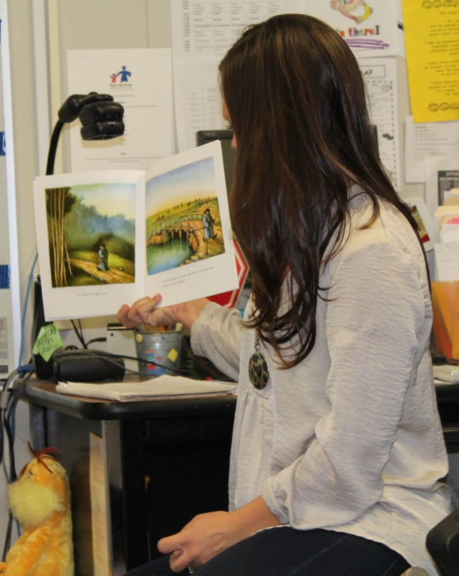
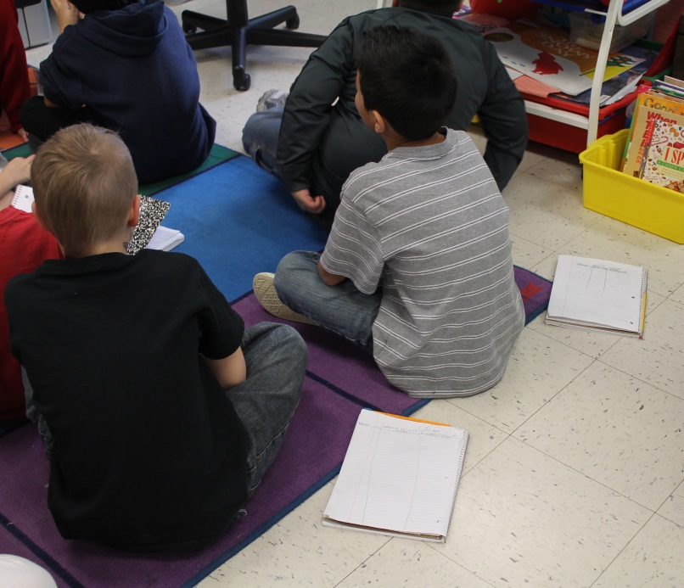
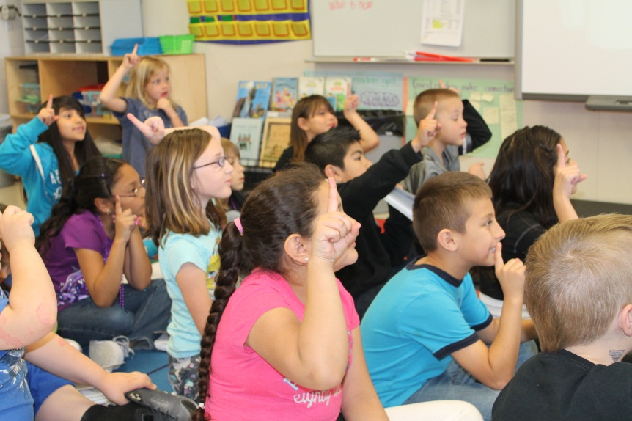
N= New Information
Students place their notebooks and pencils on the floor while Mrs. Eide reads.
Many of the students had their “light bulbs” going off throughout the story. When they hear a text talk word, a simile, or other skills they have studied, the students raise one finger next to the side of their head…this a visible cue to Mrs. Eide that the students are thinking.

Slide 9
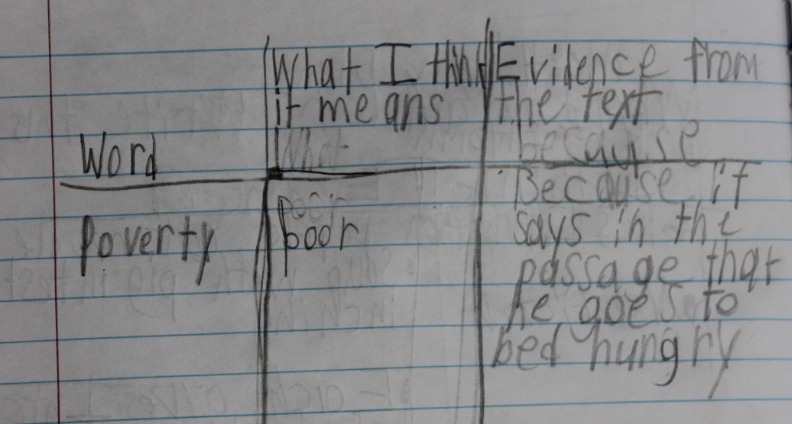
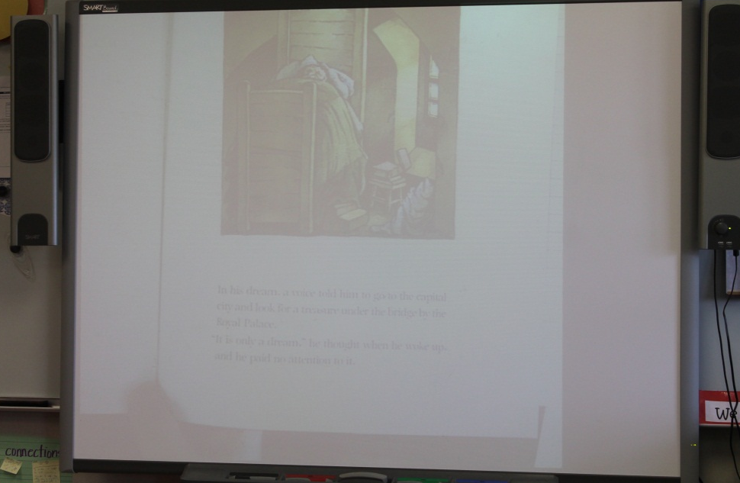
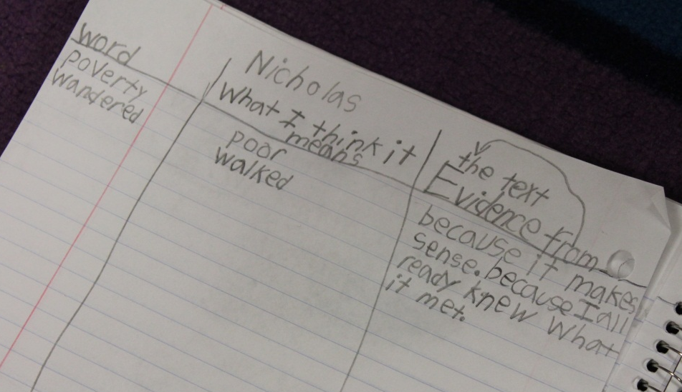

N= New Information
At strategic points in the story, Mrs. Eide stopped to discuss a word from the story. The students wrote the word, wrote their own definition, and provided evidence from the story to support their definition.

Slide 10
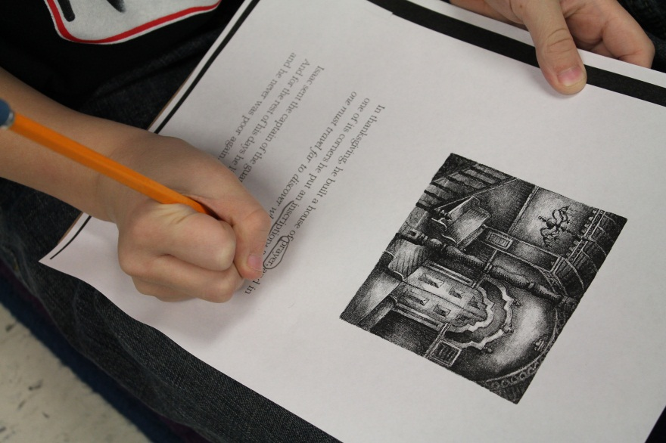
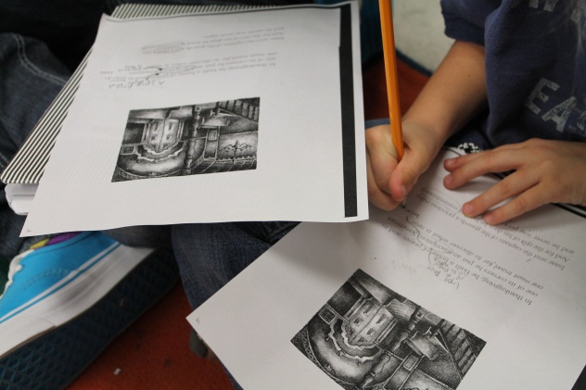
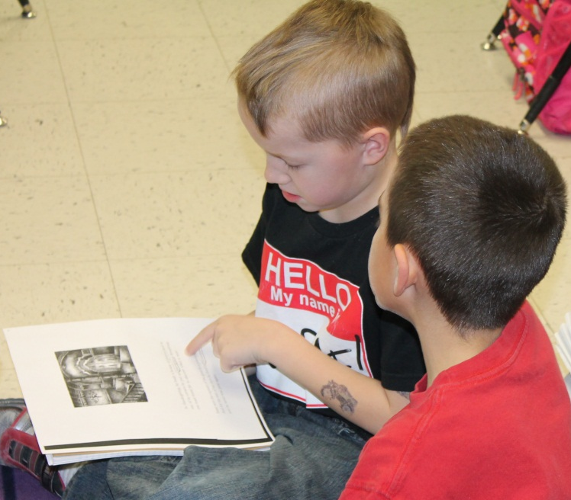
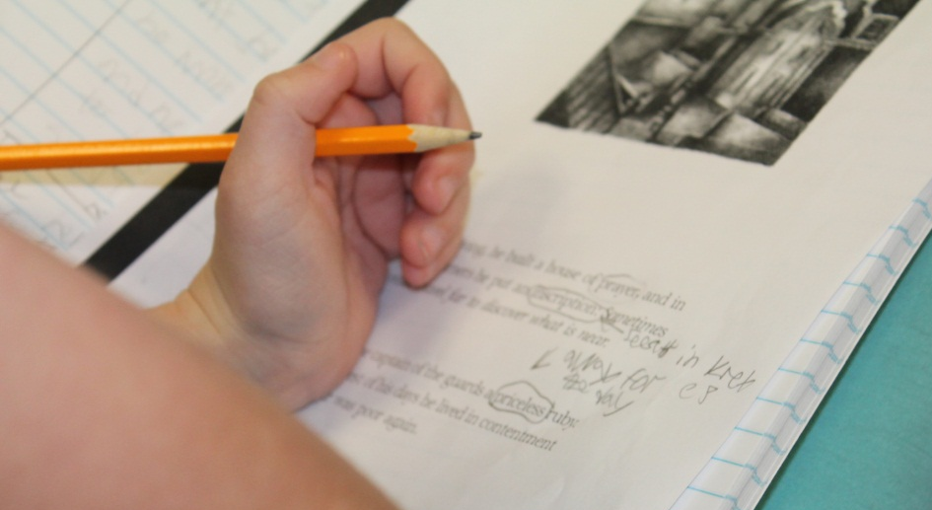
A= Apply Knowledge
Students were given the last two pages of text to read on their own.
With your learning partner, read the end of the story and circle any words that you don’t know. Use the context clues in the sentence to figure out what the word means.
(9) Generating and Testing Hypotheses
(5) Homework and Practice

Slide 11
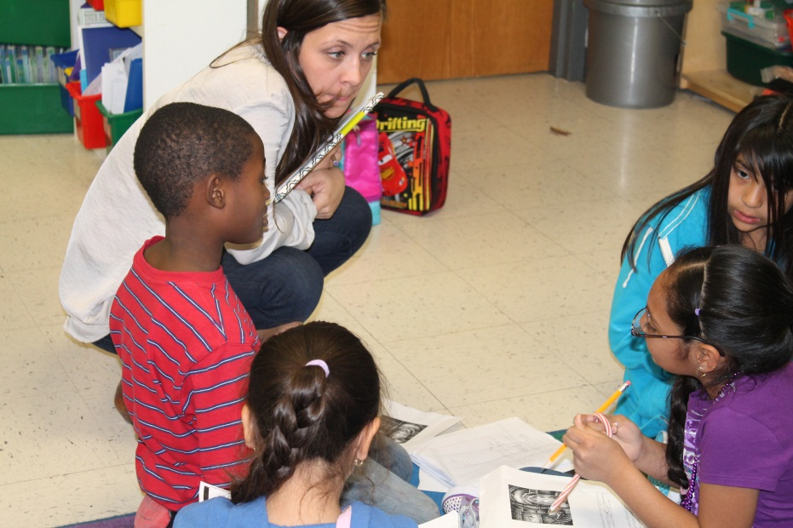
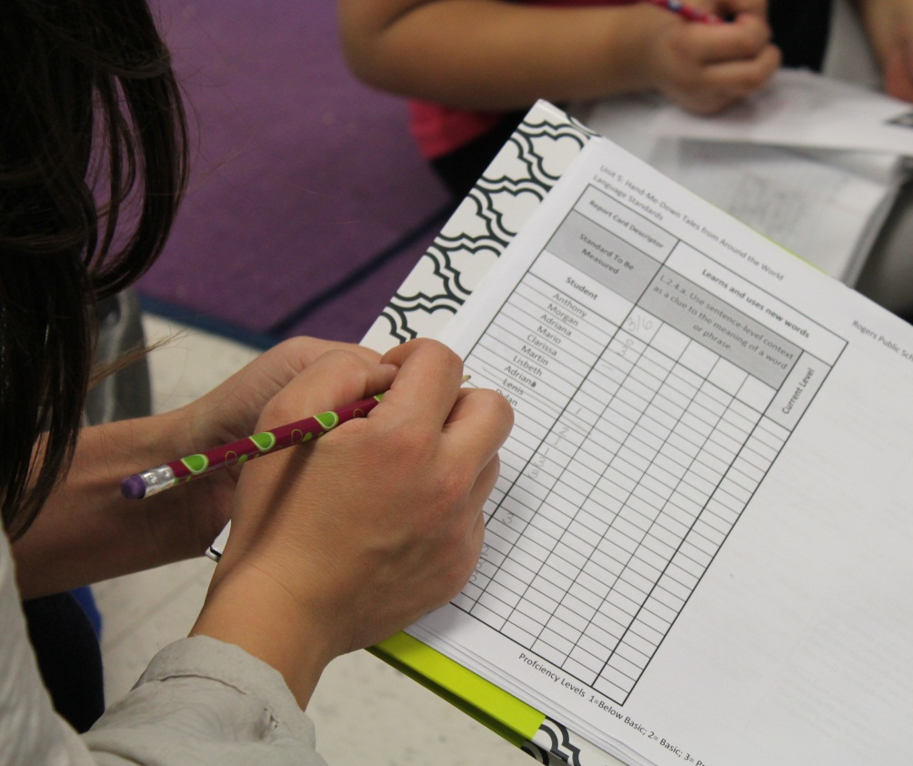
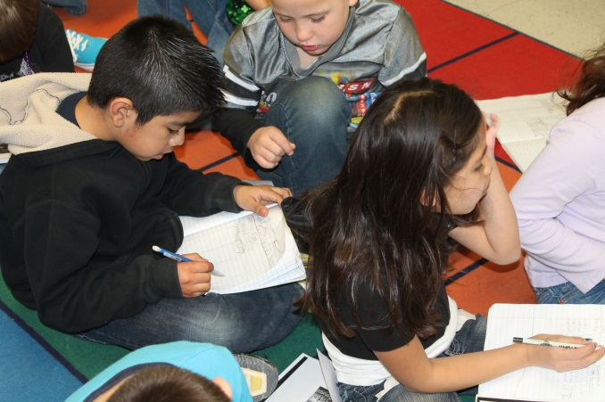
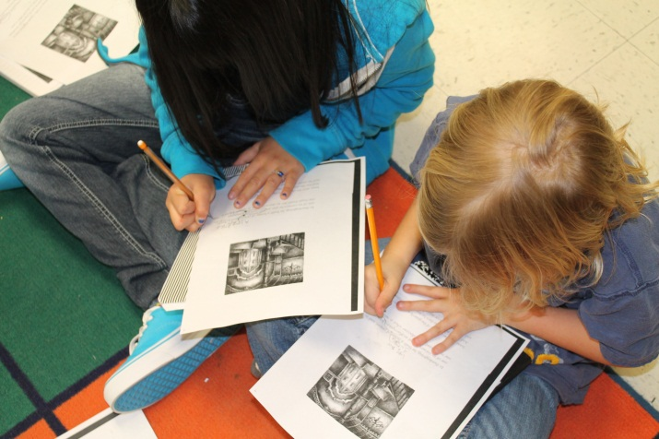
A= Apply Knowledge
As the students worked,
Mrs. Eide roamed the room with her scoring guide.
She checked in with most students to score their progress towards the standard.

Slide 12
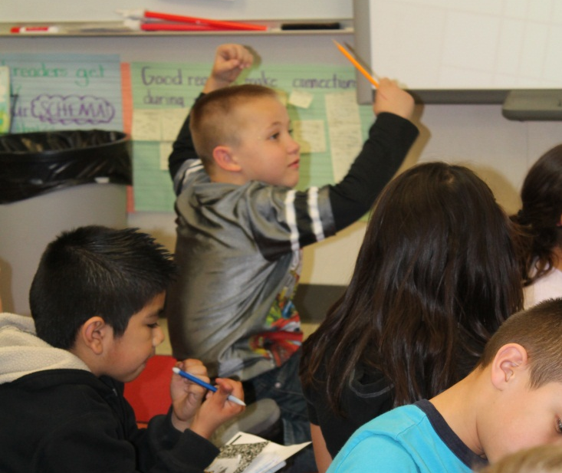
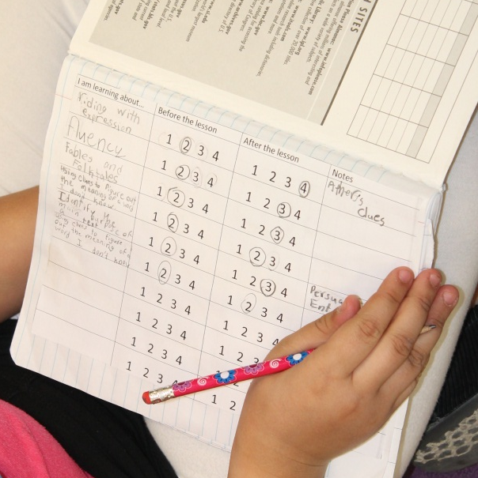
G= Generalize the Goal
(8) Setting Objectives and Providing Feedback
At the end of the lesson, students share the strategies they used to determine the definitions of unknown words. Students then revisit the goal on the goal sheet in the front of their notebook. They score themselves again to see how much they have learned.
They use the far right column to take quick notes. Today, the students had to decide why this information matters to them…how does this help you to be a better reader?
One student said, “We need to know what words mean so we can understand the story.”
This student scored herself a “2” before the lesson. After the lesson, she said she was still a “2.” She said, “I’m starting to get it, but I need more practice.”
(4) Reinforcing Effort and Providing Recognition

Slide 13
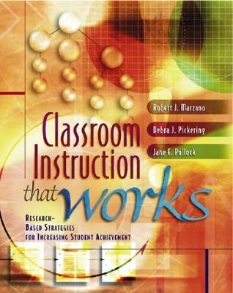
Marzano, R. J., Pickering, D. J., & Pollock, J. E. (2001). Classroom instruction that works: Research-based strategies for increasing student achievement. Alexandria, VA: Association for Supervision and Curriculum Development.
Pollock, J. E. (2007). Improving student learning one teacher at a time. Alexandria, VA: Association for Supervision and Curriculum Development.
Pollock, J. E., & Ford, Sharon M. (2009). Improving student learning one principal at a time. Alexandria, VA: Association for Supervision and Curriculum Development.

Slide 14
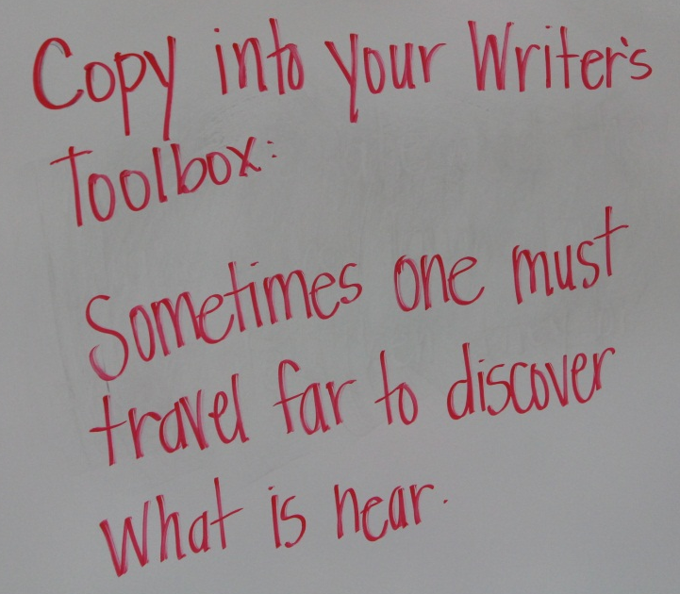
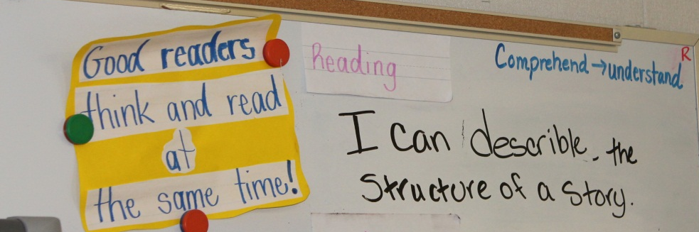
Some Things We’ve Learned about Common Core…
We have just barely scratched the surface…we still have LOTS to learn.
No one has all of the answers.
We must truly give ourselves permission to step out of the box and try…even if that means the lesson flops.

Slide 15
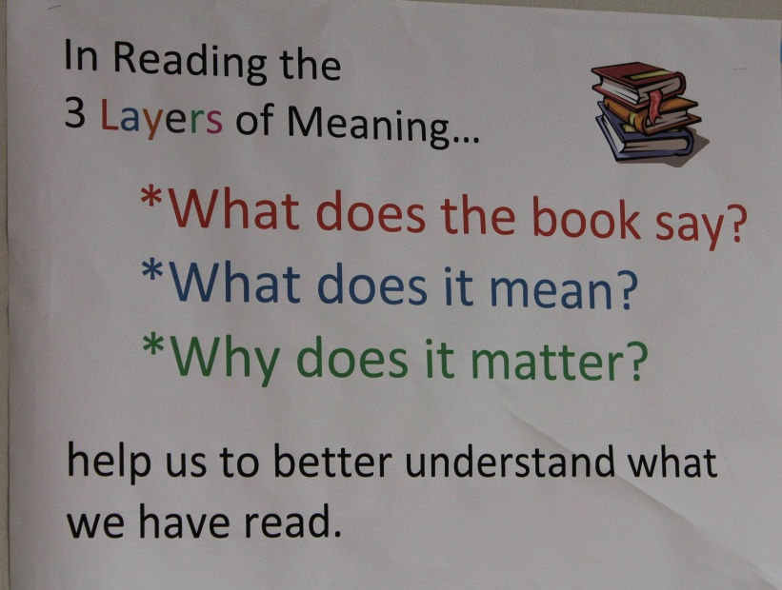
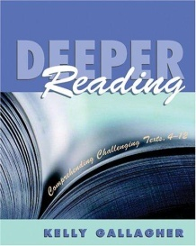
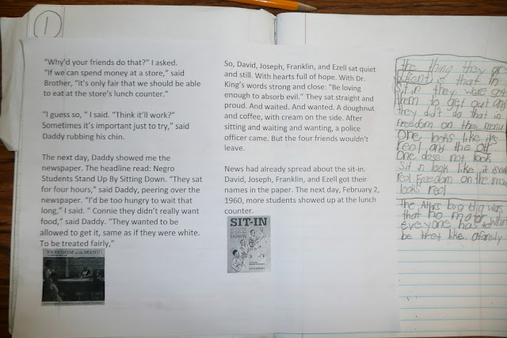
Some Things We’ve Learned about Common Core…
There are some FANTASTIC books out there that we never knew existed.
Teaching is FUN!!!
Our students can, and WILL, rise to the challenge.
Yes, this is hard. Yes, this is different. But we can do this!

Slide 16
Thanks so much for coming!!!
Lauren Eide
2nd grade
Mathias Elementary
Rogers
leide@rps.k12.ar.us
Renee Simpson
Literacy Facilitator
Mathias Elementary
Rogers
rsimpson@rps.k12.ar.us

